Slide 1
Pitch Tips
Bernie Woodcroft, ilab Program Director
2nd May to 4th May 2014

Slide 2
Pitch Types
Elevator 30 – 60 seconds
“What do you do?”
Initial Investor Pitch
Initial Investor Customer Pitch
Initial Investor Customer Co-Founder Pitch
5 - 10 minutes
Detailed Investor etc. Pitches
Deeper dive
Financial oriented, Product oriented ++
Notes:
Visit webpage

Slide 3
Elevator Pitch
30 – 60 seconds
Problem – Solution – Proof technique
You know [problem]?
Well what we do is [solution].
In fact [proof].
(refer Allan Dib)
Website Development: “You know how most company websites are out of date? Well what I do is install software that makes it easy for people to update their own websites, without the need to pay a web designer each time. In fact I installed the software for one of my clients recently and they saved $2000 a year in web development costs.
Notes:
Visit webpage

Slide 4
Initial Investor Pitch Germinator Pitch
Problem
What is the problem your startup / product is solving? What is the market pain point?
Solution
How are you solving this problem?
Market size
How big is your potential market?
Team
Who is in the team? What are their specialities? Why are they the best?
Execution plan
A rough schedule of what your business will do once in Germinate
Notes:
Visit webpage

Slide 5
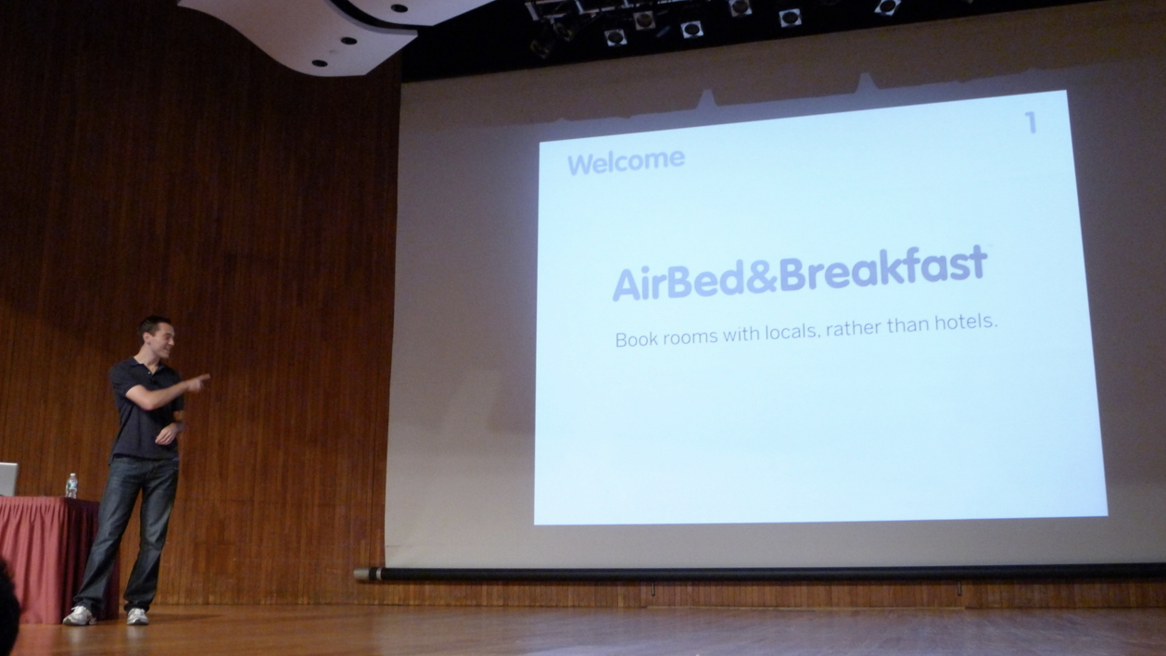
AirBnB - First Pitch Deck

Slide 6
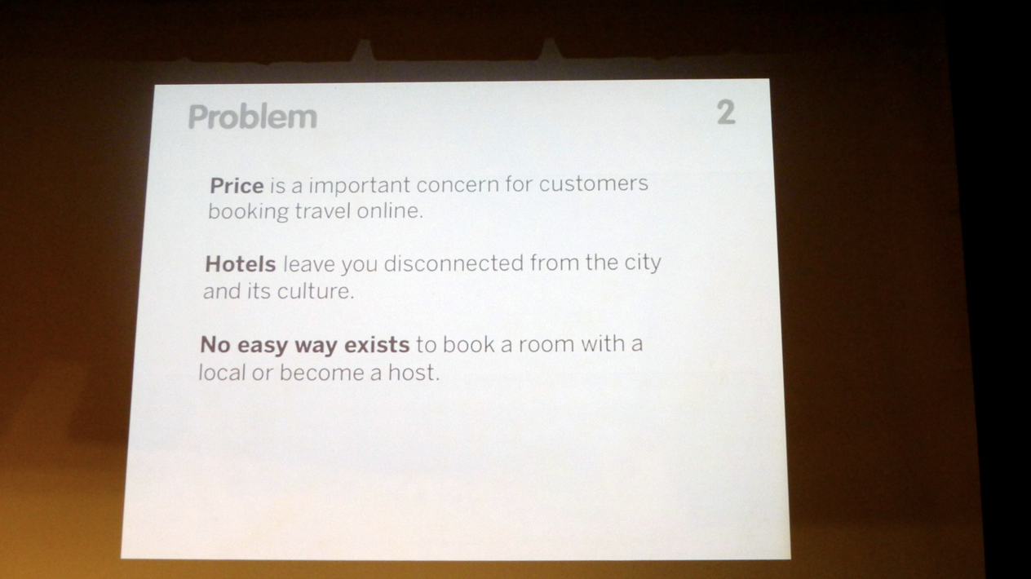
AirBnB – The Problem

Slide 7
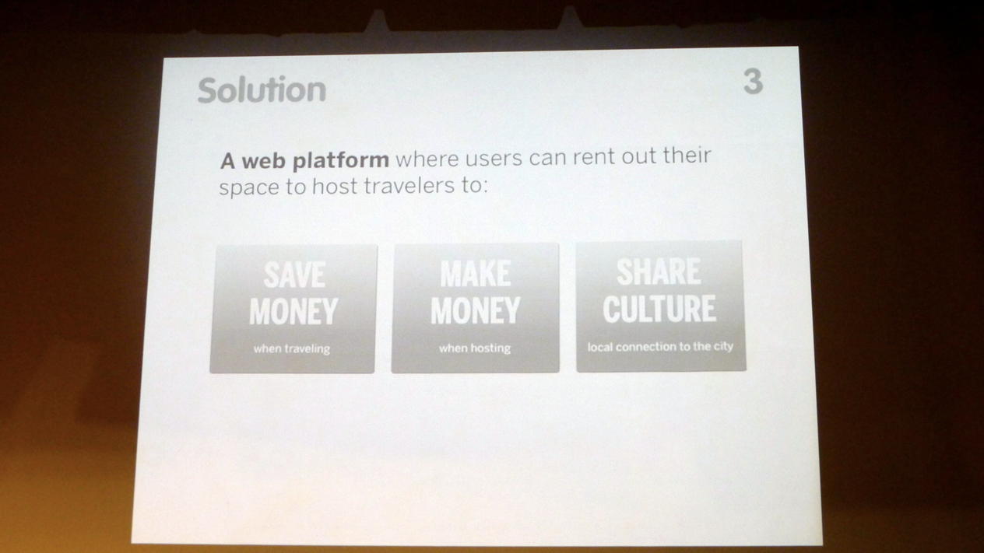
AirBnB – The Solution

Slide 8
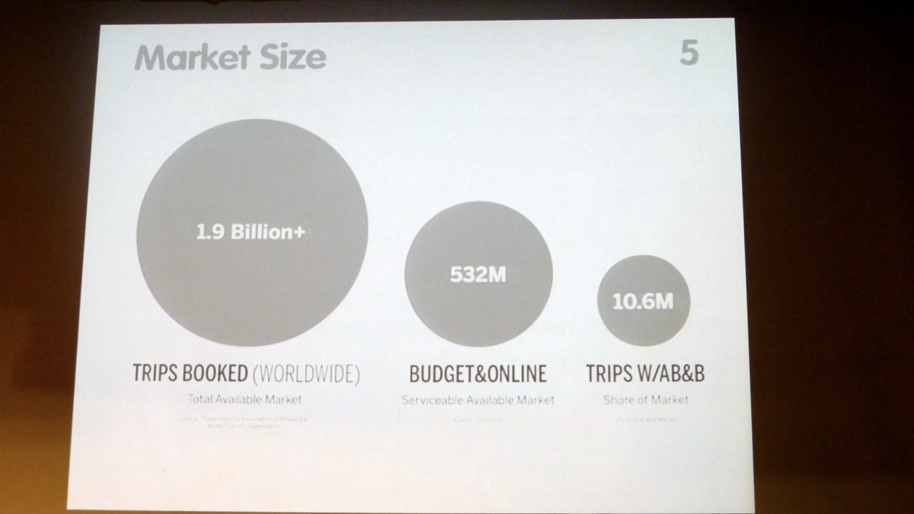
AirBnB – The Market

Slide 9
General Tips
Know your audience
Tell a compellingly simple story: shoppers buy more when they have fewer options
Become a master of exclusion – ask yourself “do they need to know this now?”
Use Images and not too much text
Present benefits rather than features
Story telling is more powerful
Use short sentences and simple words and don’t read your slides

